Slide 1
Data Mining Architecture
18CSE487T
Data Warehousing and its Applications
UNIT-4

Slide 2
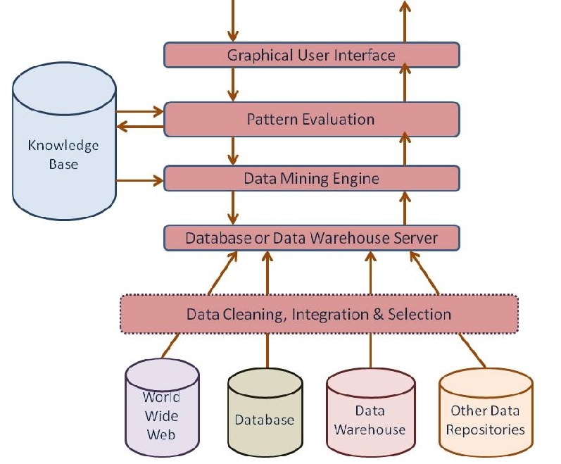
Architecture of Typical data mining system

Slide 3
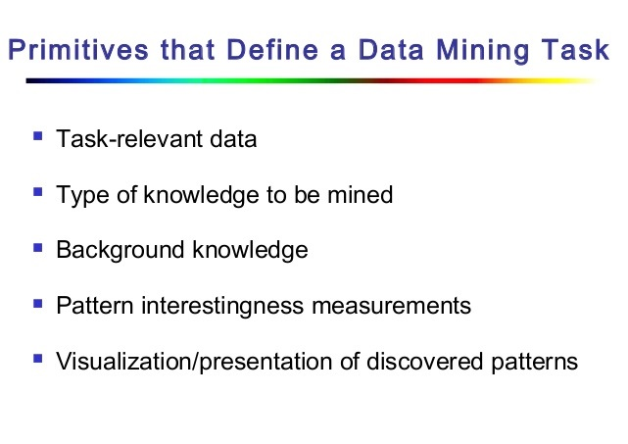
Data Mining Task Primitives

Slide 4
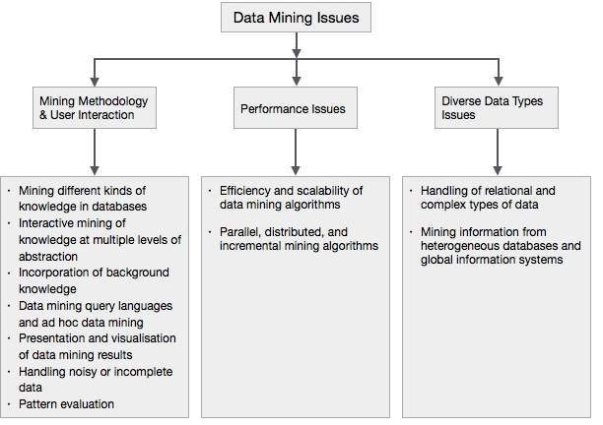
Data Mining issues

Slide 5
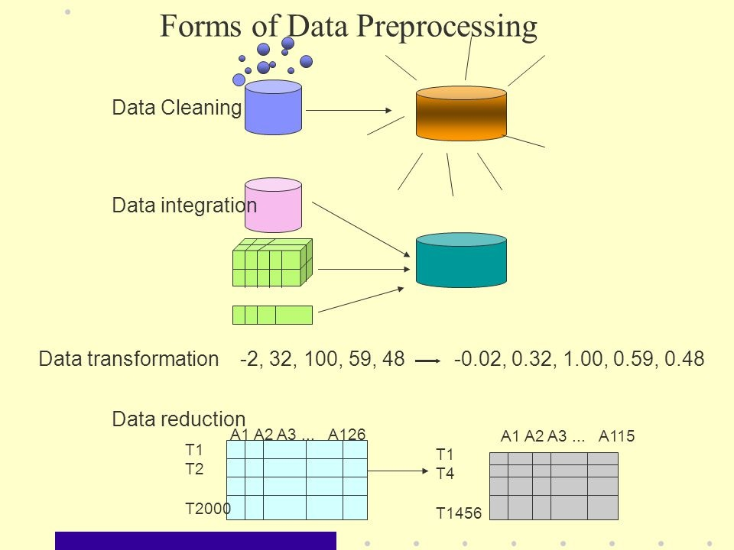
Pre processing the data

Slide 6
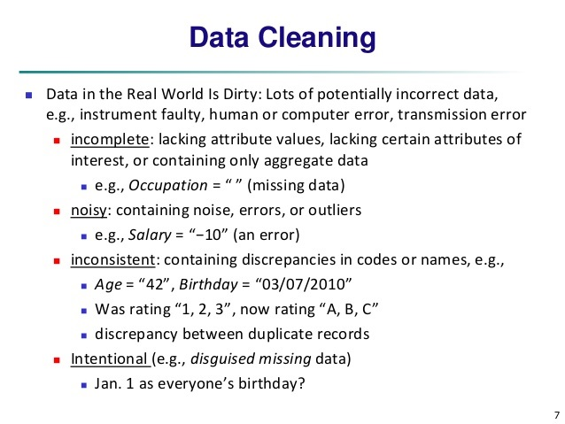
Data cleaning

Slide 7
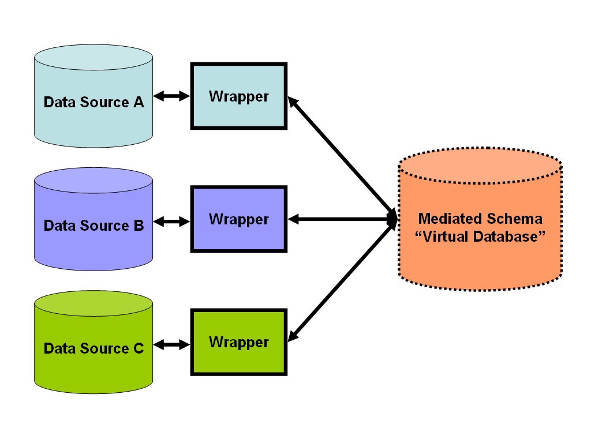
Data integration

Slide 8
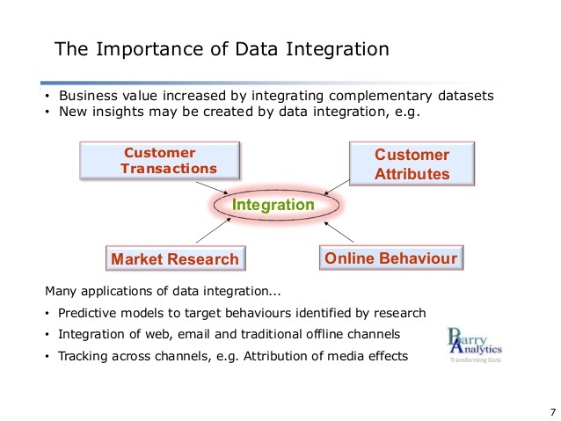
Data integration

Slide 9
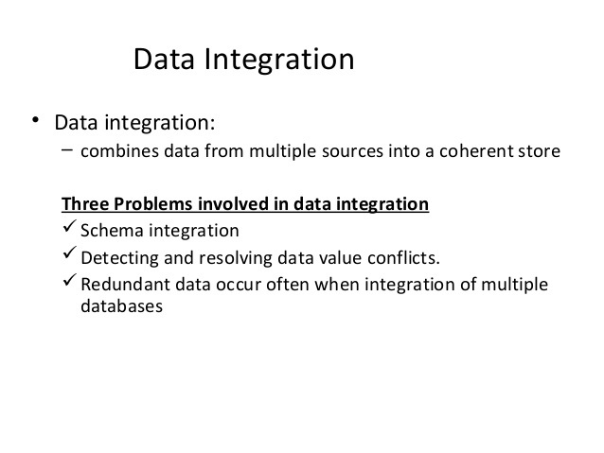
Data integration

Slide 10
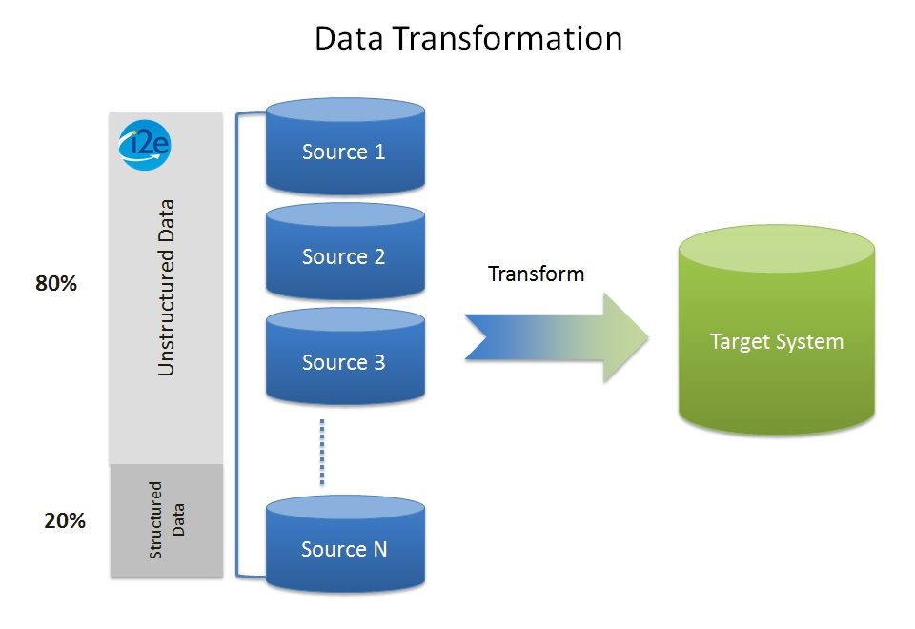
Data transformation

Slide 11
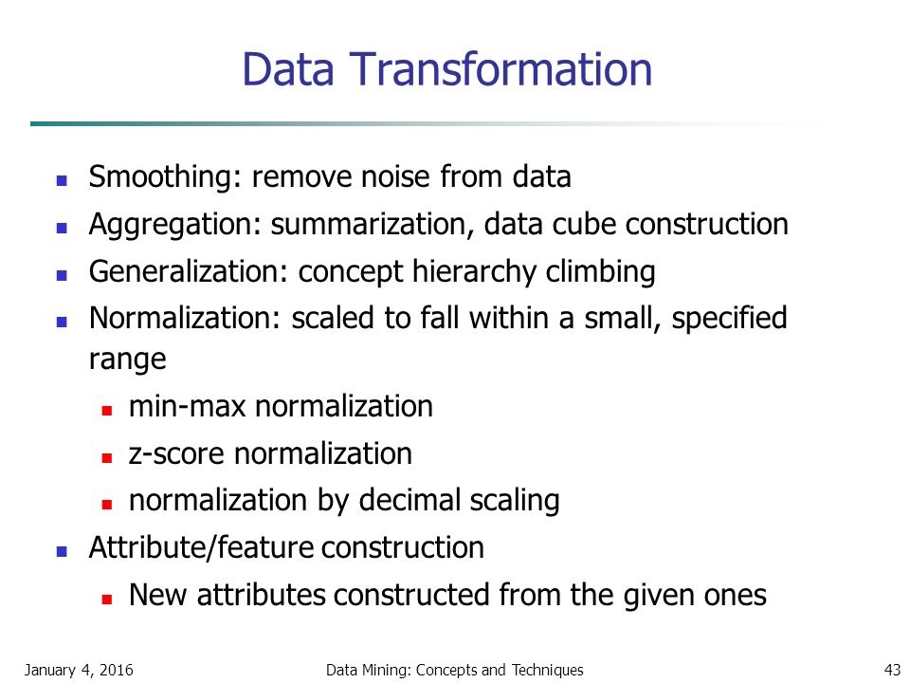
Data transformation

Slide 12
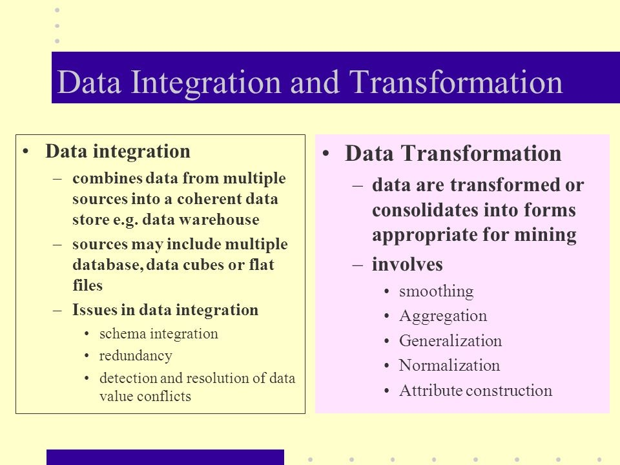
Data integration

Slide 13
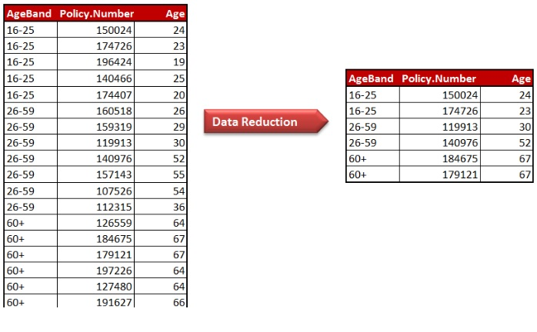
Data reduction

Slide 14
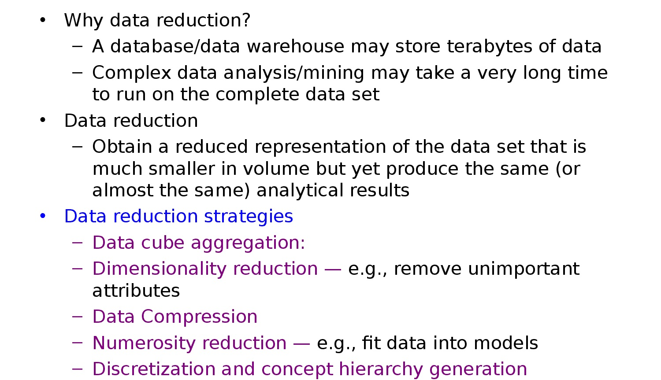
Data reduction

Slide 15
Apriori algorithm

Slide 16
Apriori ALGORITHM
An algorithm known as Apriori is a common one in data mining.
It's used to identify the most frequently occurring elements and meaningful associations in a dataset.
As an example, products brought in by consumers to a shop may all be used as inputs in this system.

Slide 17
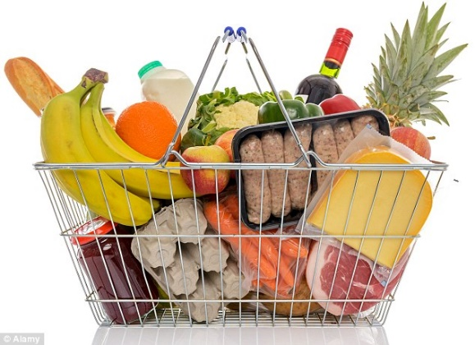
Association rule mining
Proposed by Agrawal et al in 1993.
It is an important data mining model studied extensively by the database and data mining community.
Assume all data are categorical.
No good algorithm for numeric data.
Initially used for Market Basket Analysis to find how items purchased by customers are related.
Bread → Milk [sup = 5%, conf = 100%]

Slide 18
The model: data
I = {i₁, i₂, …, i_{m}}: a set of items.
Transaction t :
t a set of items, and t ⊆ I.
Transaction Database T: a set of transactions T = {t₁, t₂, …, t_{n}}.

Slide 19
Transaction data: supermarket data
Market basket transactions:
t1: {bread, cheese, milk}
t2: {apple, eggs, salt, yogurt}
… …
tn: {biscuit, eggs, milk}
Concepts:
An item: an item/article in a basket
I: the set of all items sold in the store
A transaction: items purchased in a basket; it may have TID (transaction ID)
A transactional dataset: A set of transactions

Slide 20
Transaction data: a set of documents
A text document data set. Each document is treated as a “bag” of keywords
doc1: Student, Teach, School
doc2: Student, School
doc3: Teach, School, City, Game
doc4: Baseball, Basketball
doc5: Basketball, Player, Spectator
doc6: Baseball, Coach, Game, Team
doc7: Basketball, Team, City, Game

Slide 21
The model: rules
A transaction t contains X, a set of items (itemset) in I, if X ⊆ t.
An association rule is an implication of the form:
X → Y, where X, Y ⊂ I, and X ∩Y = ∅
An itemset is a set of items.
E.g., X = {milk, bread, cereal} is an itemset.
A k-itemset is an itemset with k items.
E.g., {milk, bread, cereal} is a 3-itemset

Slide 22
Rule strength measures
Support: The rule holds with support sup in T (the transaction data set) if sup% of transactions contain X ∪ Y.
sup = Pr(X ∪ Y).
Confidence: The rule holds in T with confidence conf if conf% of tranactions that contain X also contain Y.
conf = Pr(Y | X)
An association rule is a pattern that states when X occurs, Y occurs with certain probability.

Slide 23
Support and Confidence
Support count: The support count of an itemset X, denoted by X.count, in a data set T is the number of transactions in T that contain X. Assume T has n transactions.
Then,

Slide 24
Goal and key features
Goal: Find all rules that satisfy the user-specified minimum support (minsup) and minimum confidence (minconf).
Key Features
Completeness: find all rules.
No target item(s) on the right-hand-side
Mining with data on hard disk (not in memory)

Slide 25
An example
t1: Beef, Chicken, Milk
t2: Beef, Cheese
t3: Cheese, Boots
t4: Beef, Chicken, Cheese
t5: Beef, Chicken, Clothes, Cheese, Milk
t6: Chicken, Clothes, Milk
t7: Chicken, Milk, Clothes
Transaction data
Assume:
minsup = 30%
minconf = 80%
An example frequent itemset:
{Chicken, Clothes, Milk} [sup = 3/7]
Association rules from the itemset:
Clothes → Milk, Chicken [sup = 3/7, conf = 3/3]
… …
Clothes, Chicken → Milk, [sup = 3/7, conf = 3/3]

Slide 26
